Slide 1
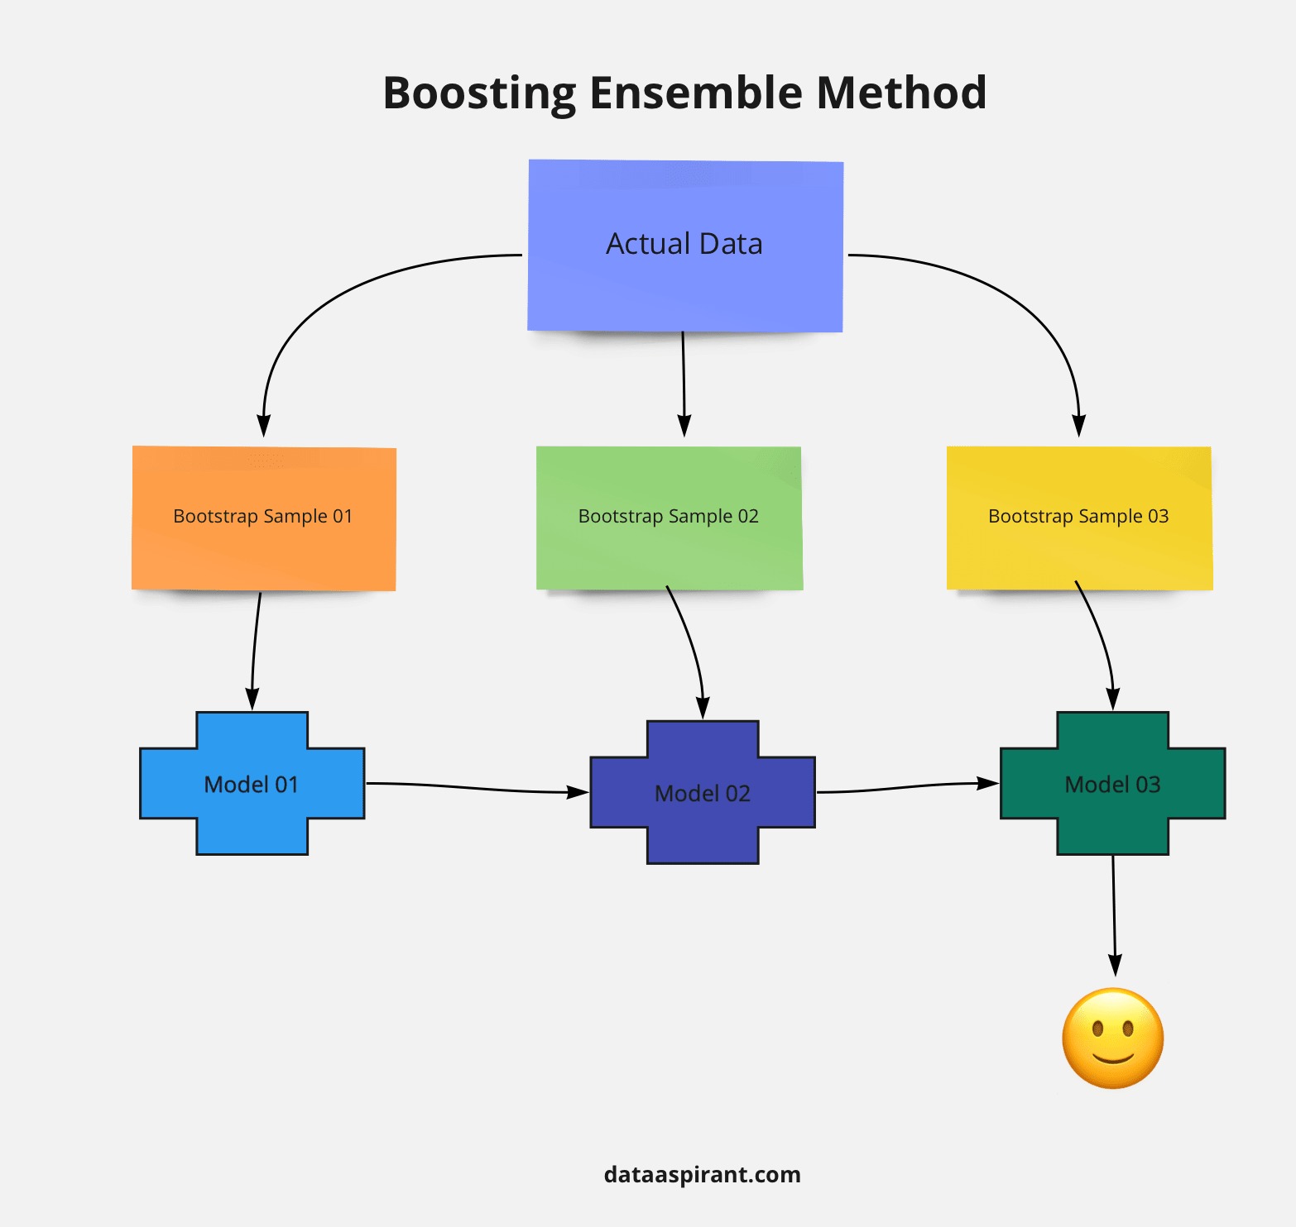
Boosting Algorithm - Regression
Boosting algorithms in regression use an ensemble of “weak leaners” to build a strong predictive model, iteratively improving predictions by focusing on errors from previous models.
Common Boosting Algorithms for Regression:
Ada Boost
XG Boosting
LG Boosting

Slide 2
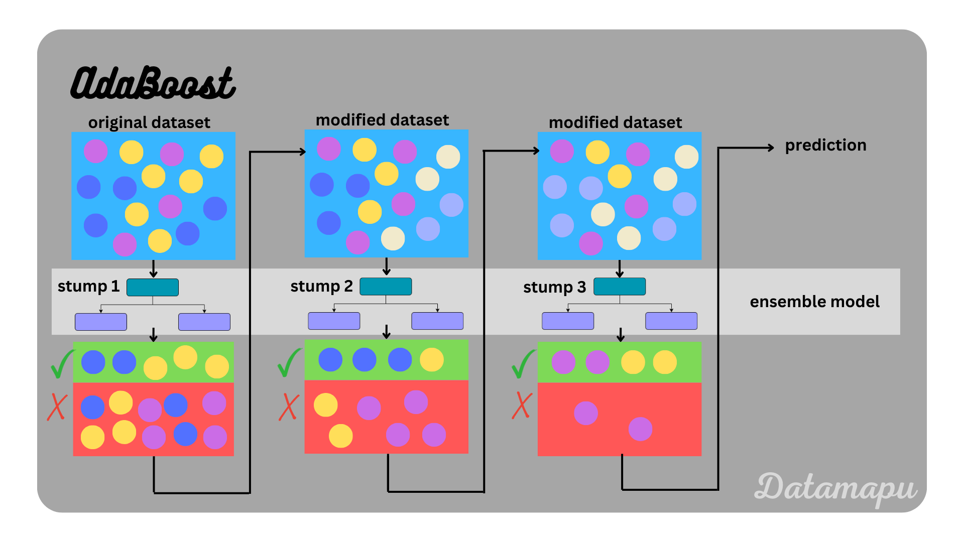
Ada Boost
AdaBoost (Adaptive Boosting) is a machine learning ensemble method that combines multiple weak classifier to create a strong predictive model. It works by iteratively training weak learners on weighted versions of the training data, where weights are adjusted based on previous mistakes.

Slide 3
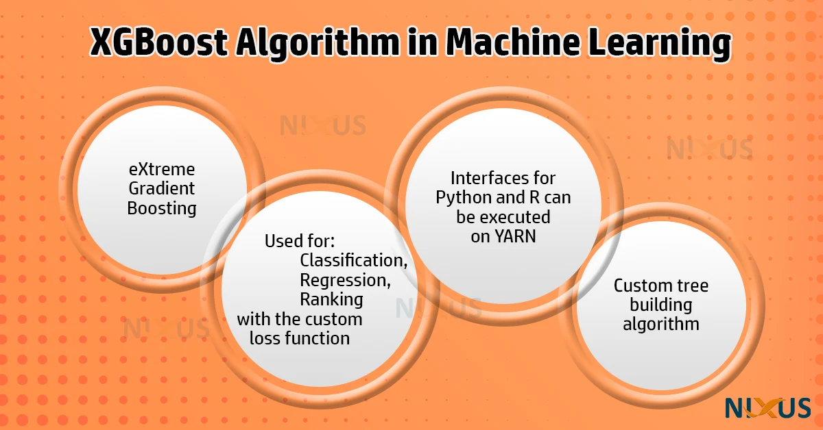
XG Boosting
XG Boost (eXtreme Gradient Boosting) is powerful open-source machine learning algorithm that utilizes gradient boosting on decision trees. It’s known for its high accuracy, speed, and efficiency, particularly when dealing with large data sets. XGBoost is a popular choice for various machine learning tasks, including classification and regression and has been used to win numerous competitions.

Slide 4
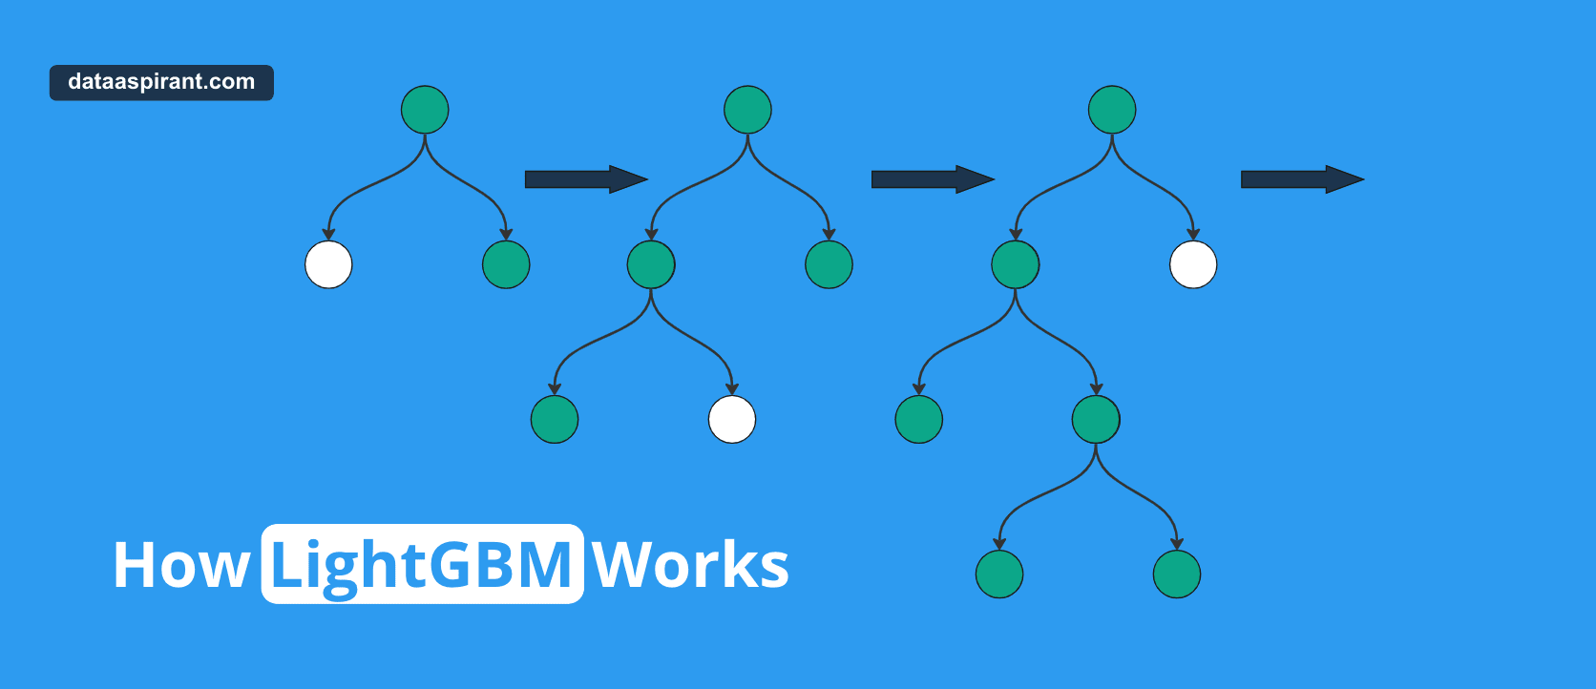
LG Boosting
LG Boosting (Light Gradient Boosting Machine) is an open-source high performance framework developed by Microsoft. It is an ensemble learning framework that uses gradient boosting method which constructs a strong learner by sequentially adding weak learners in a gradient descent manner.

